Slide 1
SLiM: Genetic Constraint
Nick O’Brien
Notes:
Talk about how my current model is building on my honour’s stuff, this time focusing on how per-gene constraints on adaptation alter trajectories of populations adapting, and maintaining adaptedness

Slide 2
What is “Genetic Constraint”?
Notes:
By genetic constraint what I’m talking about is the ability of a gene to evolve freely, or produce phenotypes that may be adaptive. In more conserved genes, like those encoding histones, most mutations are highly deleterious, so you could say genetic constraint is high. Another way to phrase this is the number of viable mutations that can occur at a locus.
To go into more detail on this, I’ll describe a bit of the neutral theory of molecular evolution

Slide 3
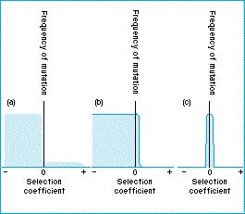
Neutral Theory
Most mutations are strongly deleterious.
These are usually efficiently purged by background selection.
The remaining mutations are mostly neutral.
Hence most evolution should occur by drift.
Advantageous mutations occur exceedingly rarely.
https://www.blackwellpublishing.com/ridley/tutorials/Molecular_evolution_and_neutral_theory2.asp
Notes:
Neutral theory suggests that most mutations that arise are deleterious, and quite strongly so. These usually kill the organism or make them sterile. Less common are purely neutral mutations, which may alter phenotypes, but do so to a tiny extent, or are synonymous mutations. The result is that these mutations have no effect on fitness. Beneficial mutations occur extremely rarely, and so are unlikely to contribute to evolution very often.
Since most mutations are deleterious, and as a result purged from the population quickly by background selection, most evolution falls to the neutral mutations – resulting in evolution by drift being predicted by neutralists to be most common.

Slide 4
Neutral Theory
a) Selectionist view
b) Neutralist view
c) Pan-neutralist view
https://www.blackwellpublishing.com/ridley/tutorials/Molecular_evolution_and_neutral_theory2.asp
Notes:
Of course, our schools of thought have changed over the years, and this figure shows how different theories perceive relative rates of mutation
The selectionists view adaptation as the most common force of evolution, with many beneficial mutations occurring
The neutralists view drift as the most common driver of evolution, with very few beneficial mutations (small sliver here)
Pan-neutralists view selection as a hoax, with all mutations (or at least the majority of them) being selectively neutral

Slide 5
Neutral Theory and Quantitative Genetics
Trait 2
Trait 1
https://www.blackwellpublishing.com/ridley/tutorials/Molecular_evolution_and_neutral_theory2.asp
Notes:
This is well and good on a single locus basis, with fitness being derived from alleles directly, but how it fits into a polygenic model is a little more of a pain. Each locus that contributes to a trait’s phenotype should have it’s own graph that looks somewhat like this, with different frequencies of deleterious, neutral, and beneficial mutations, depending on the per-gene level of constraint. The difference in a quantitative framework is what constitutes ‘beneficial’ depends on the environmental context. For example if the population is at the red circle, and gains a mutation that moves it here, that’s beneficial – but if it were closer to start with, that’s deleterious. Luckily Fisher thought about that when developing the geometric model (the left image), and produced a way to standardize allelic effects by the distance from the optimum.

Slide 6
Neutral Theory and Quantitative Genetics
Any number of these are explorable
- 0 +
- 0 +
- 0 +
Selection coefficient
Selection coefficient
Selection coefficient
Notes:
Simulation allows us to specify inputs which are normally invisible to experimental researchers. For example, we can specify these levels of genetic constraint, by the rates of deleterious, neutral, and beneficial mutations, and then we can investigate how allele frequencies at each of these loci, or summed, change over time. For example, we could set high levels of genetic constraint across the genome, restricting the ability of many genes to evolve, or vice versa. We can also change the shape of the mutational frequency spectrum (the graph here) to approximate any of these conditions, or anything in-between. For example, we could use a selectionist approach, a neutralist, somewhere in-between, or the chaotic neutral pan-neutralist approach if we dared.

Slide 7
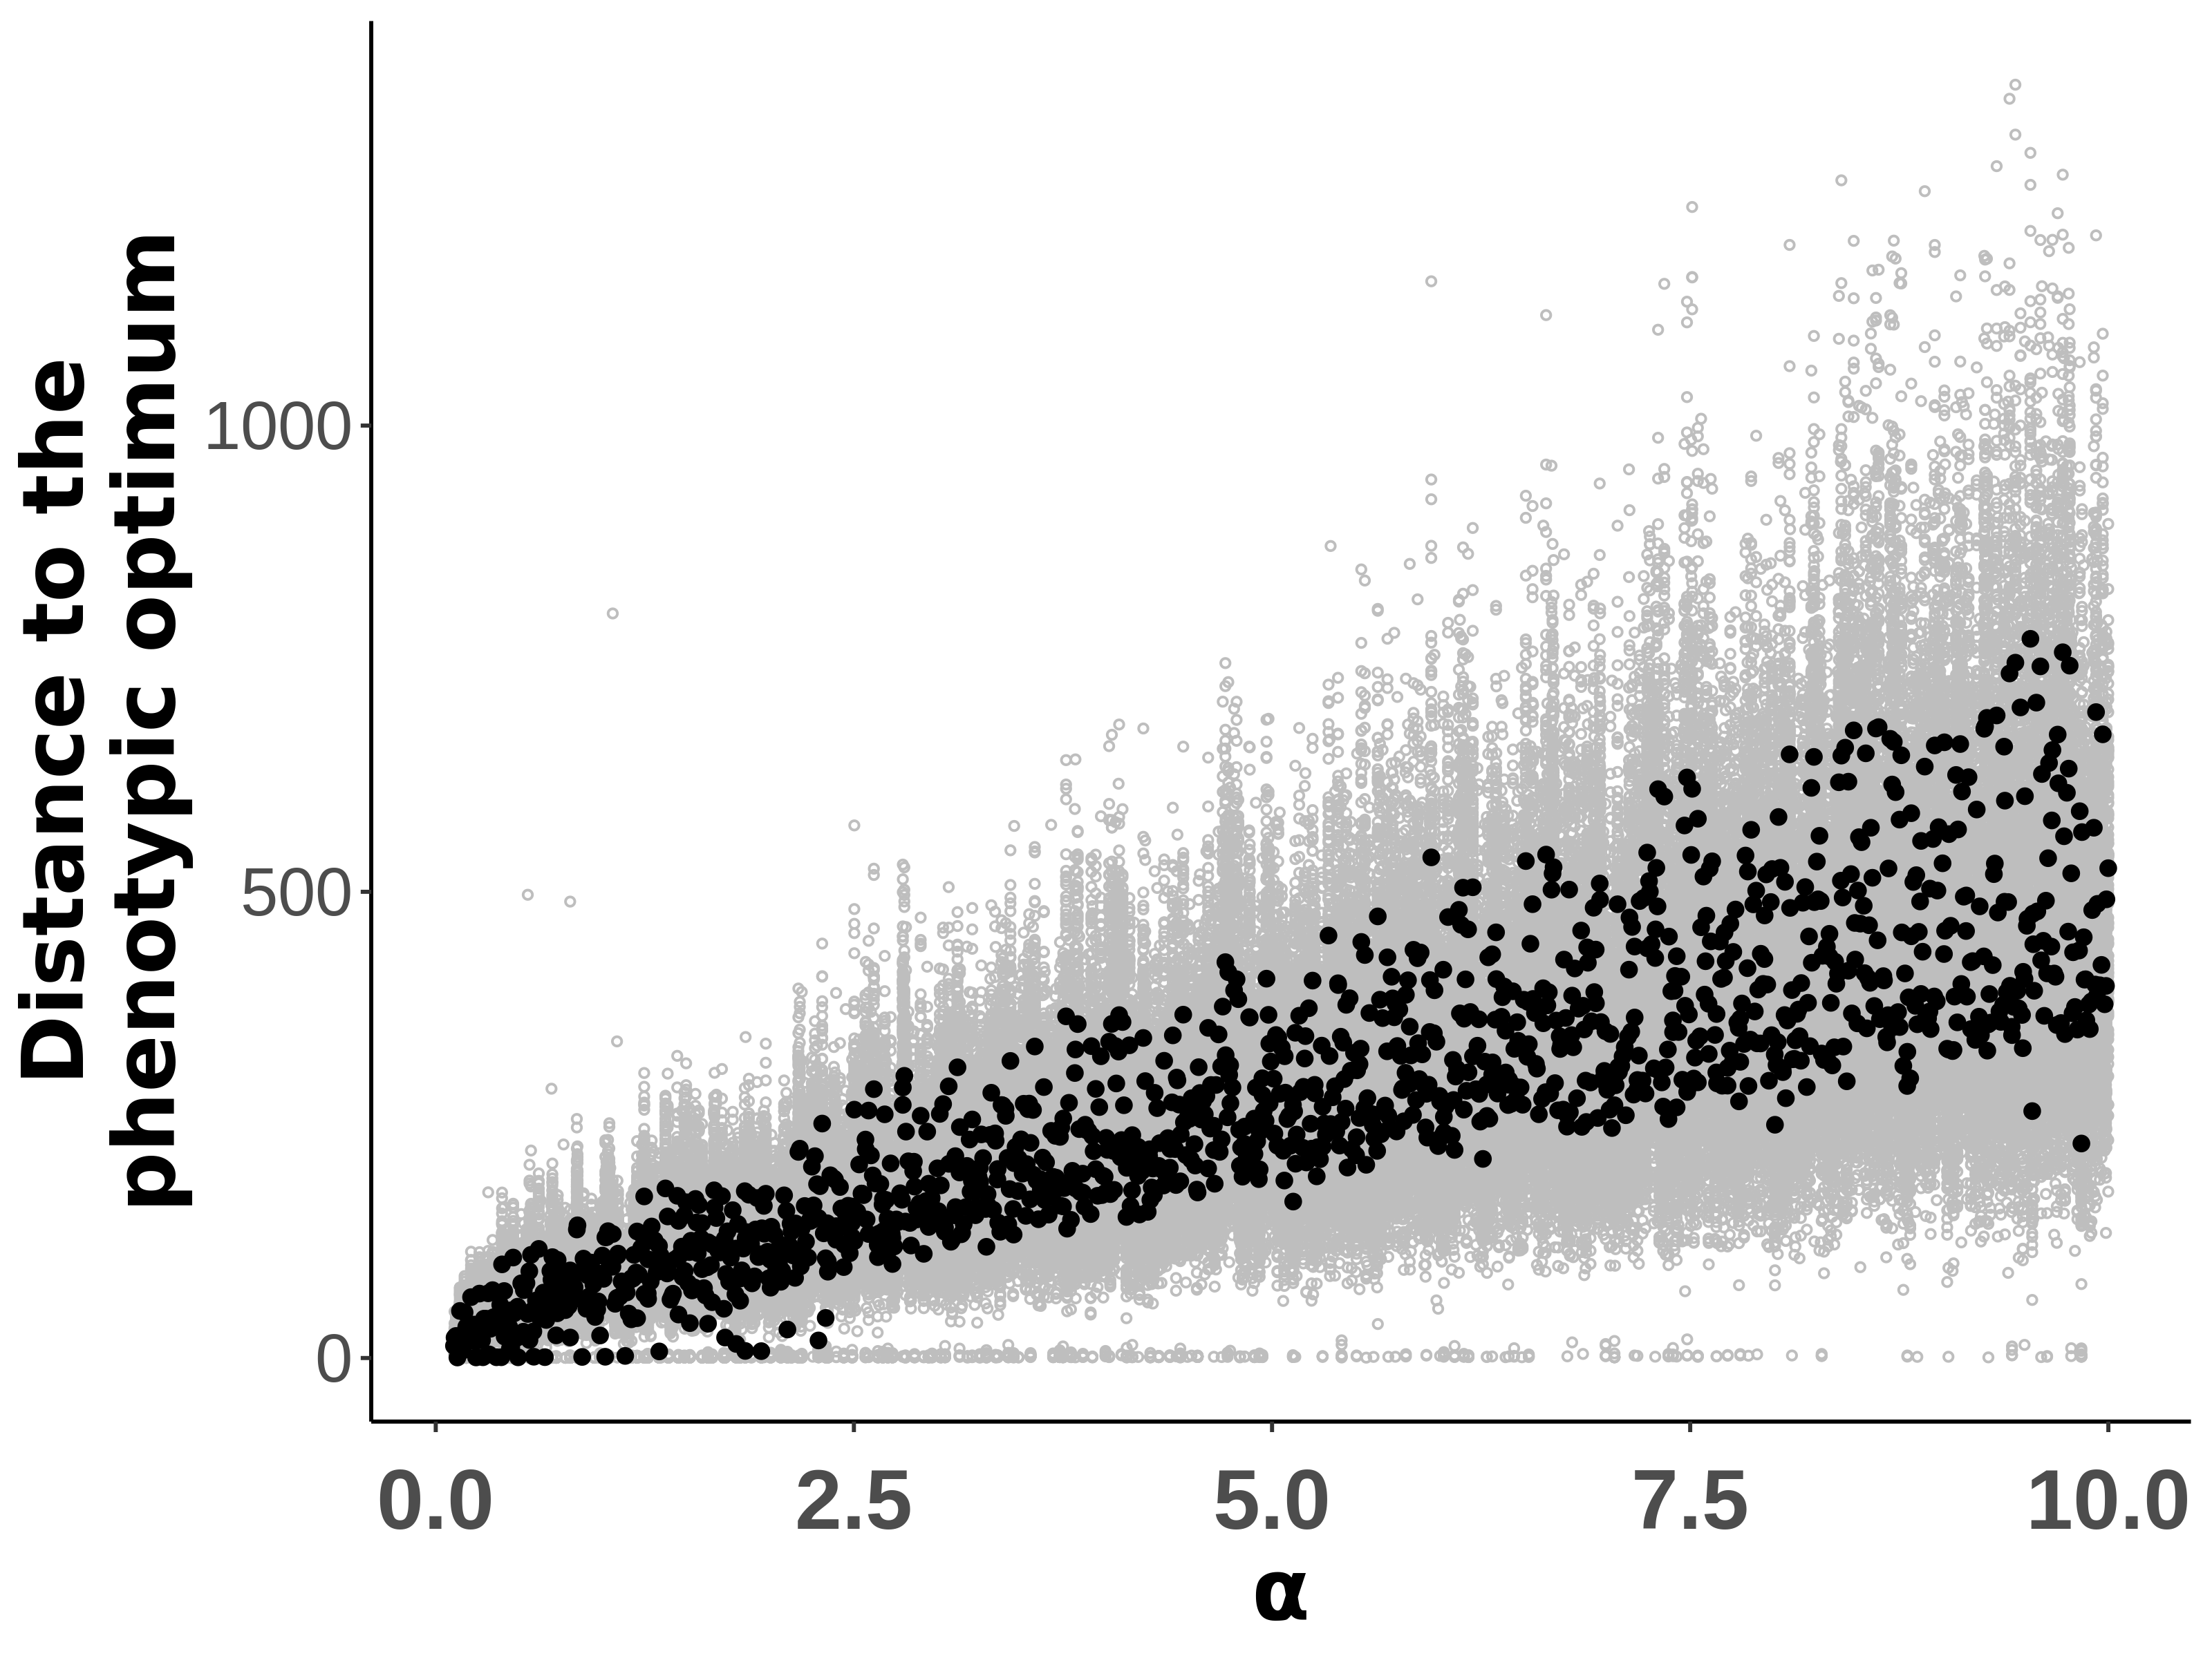
The Old Model
Notes:
All of this builds on what I was getting to in Honours – one of my most interesting findings was how variable mutation effects affected a population’s ability to maintain its position around the optimum. Here, increasing alpha represents increasing mutational variability. As mutational input becomes more variable, with more frequent large size effects, the population becomes more maladapted, hovering further from the phenotypic optimum.

Slide 8
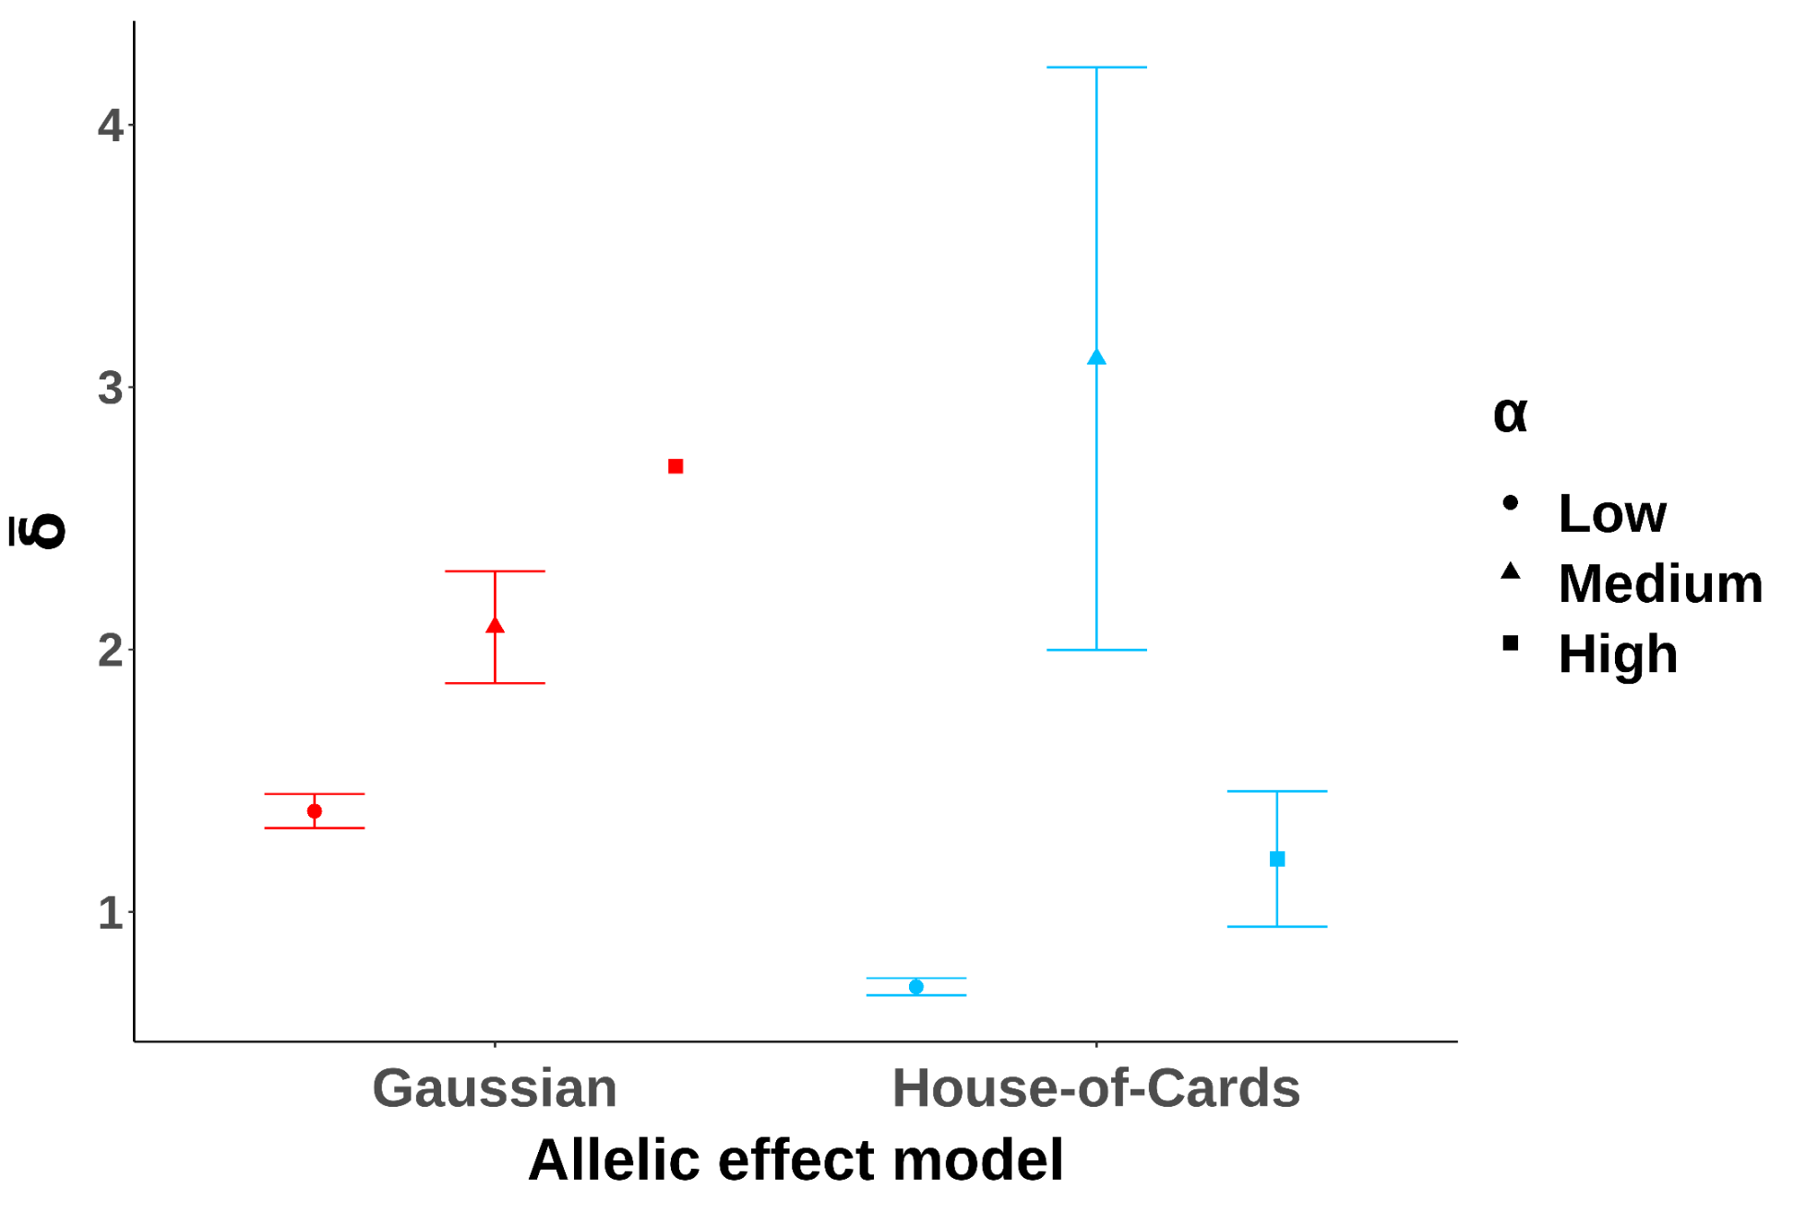
N = 1
N = 3
Distance to the phenotypic optimum
Notes:
But this differed between two different selection regimes: high mutation rates and weak selection, the Gaussian model, suffered more when mutational effects were highly variable. Populations under low mutation rates and strong selection were more robust to this mutational variation, being able to more efficiently purge deleterious mutations and maintain closer positions to the optimum.

Slide 9
Gaussian populations
House-of-Cards populations
Trait 2
Trait 2
Trait 1
Trait 1
Notes:
By using genetic constraint, we are effectively creating these Gaussian and House-of-Cards scenarios but on a per-gene rather than a per-individual level. More constrained genes should be more similar to House-of-Cards models, with fewer QTL mutations occurring relative to deleterious ones that are purged quickly. Genes with less restriction are more similar to Gaussian models, with rates of QTL mutation increasing, and the average cost of that mutation decreasing.

Slide 10

Notes:
Since I’ve shifted my focus, I’ve also simplified the model in some areas to make it more performant. I’m modelling a single trait now instead of 8, and have cut all mentions of the cursed word ‘pleiotropy’ from the script. I’ve also optimized bunch of my code, which has also been inherited in some of my Polygenic Adaptation in SLiM resources. Feel free to follow me on GitHub and I’ll give you access to the PolygenicSLiMBook so far – I have tutorials for how to set up SLiM on a Windows machine, and generally navigating a Linux installation on Windows via WSL, as well as the beginnings of a series of tutorials and templates for using SLiM to model polygenic adaptation. I also have a template SLiM script for you to muck around with, which has a lot of parameters to play around with, without needing worry too much about the programming side of it.

Slide 11
Genetic Constraint at a locus | Odds of deleterious mutation relative to beneficial | Odds of neutral mutation relative to beneficial
Low | 1 | 1
Medium | 10 | 5
High | 100 | 50
Table 1: Relative chance of a mutation of a given type occurring at a locus constrained by a certain level of genetic constraint.
Notes:
So I’ve run some simulations to test the waters on the effects of genetic constraints during and following adaptation, looking at the allele frequencies of constrained genes versus those which are not, and under different levels of mutational variability. In these examples, low constraint means that neutral, deleterious, and trait-affecting alleles are equally likely to appear at a given locus; medium constraint means that deleterious alleles are 10 times more likely to appear than QTL mutations, and neutral are 5 times more likely; and high constraint means that deleterious alleles are 100 times more likely to arise at a highly-constrained locus than QTL mutations; neutral alleles are 50 times more likely to arise than QTL mutations in this case.

Slide 12
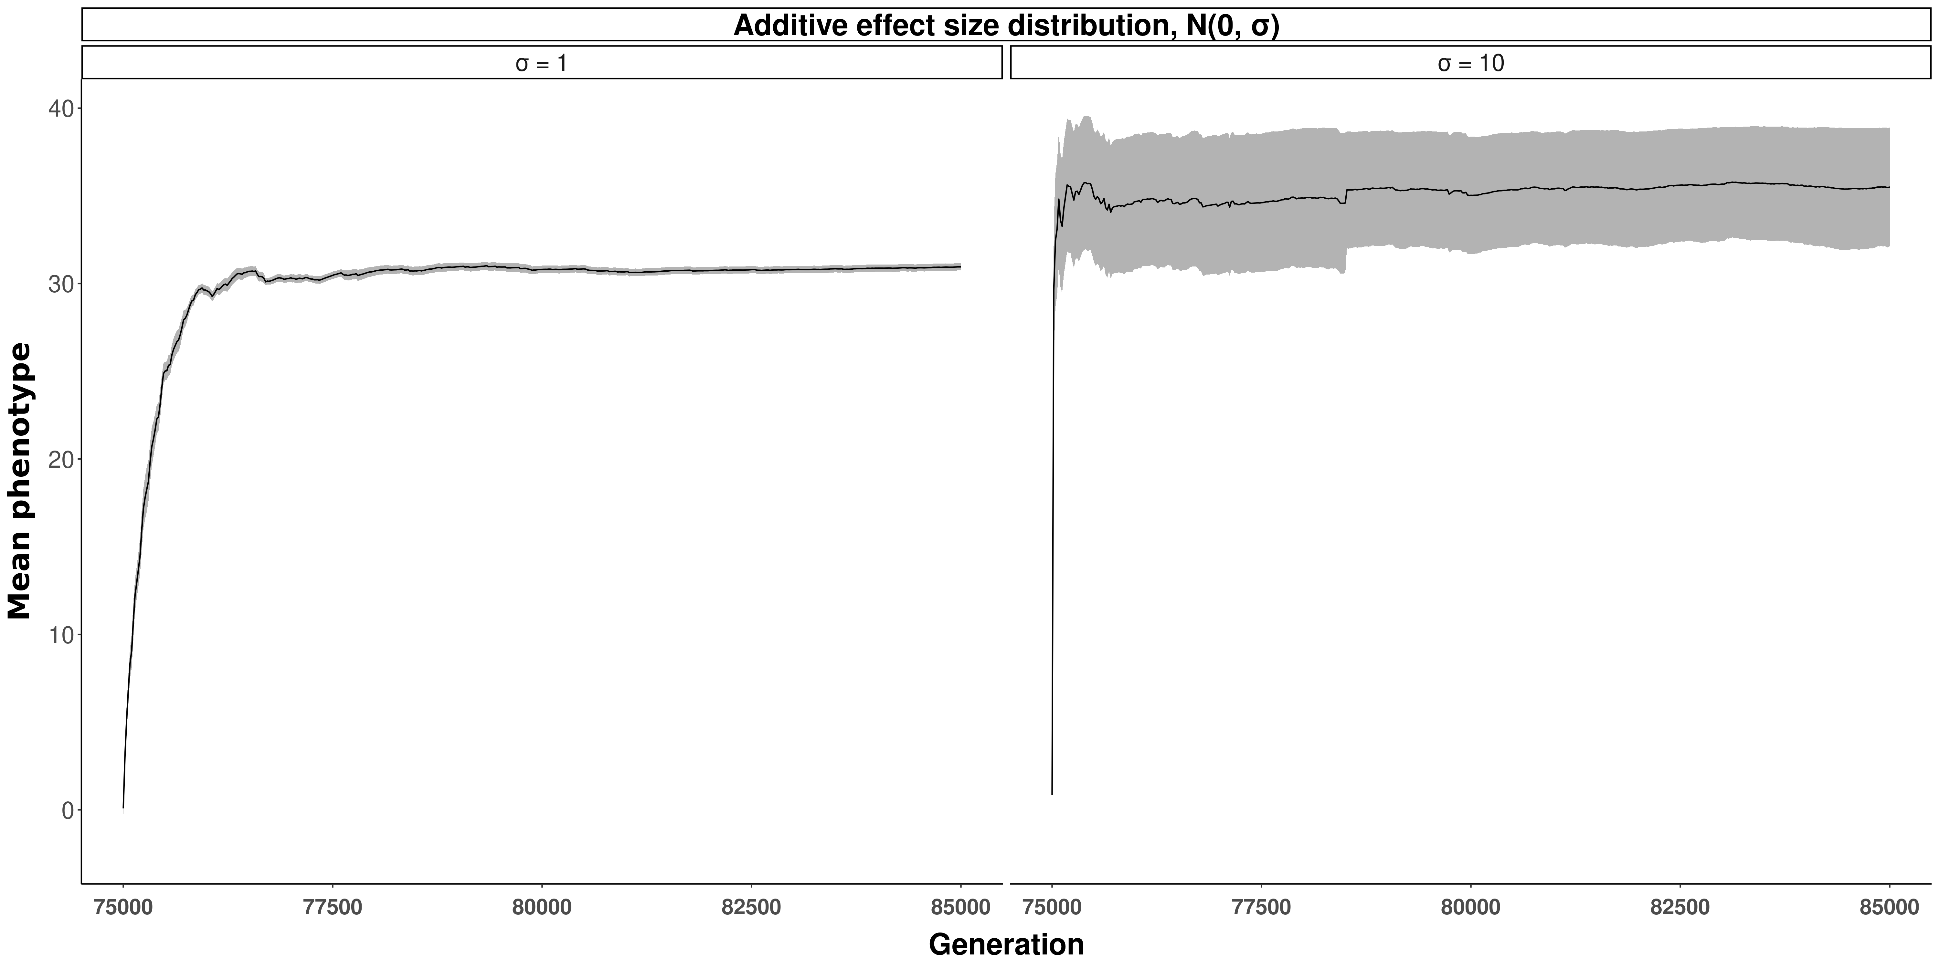
Notes:
First, we’ll get an idea of how the phenotype is tracking over time. For reference, the optimum is set at phenotype = 30.
In general, populations with low mutational variability (shown on the left, with sigma = 1) reach the optimum within about 1500 generations and stay relatively close to that.
When sigma = 10, so there’s more mutational variability, populations adapt much faster, within 100 generations, but they are more maladapted on average, being further from the optimum, and their position varies a lot over time.
So, now we can look at the underlying alleles controlling these changes in phenotype for both low and high mutational variability. Specifically, we’ll look at fixations of alleles, which are expected to follow an exponential distribution – where many small effect mutations fix, and a few large ones.

Slide 13
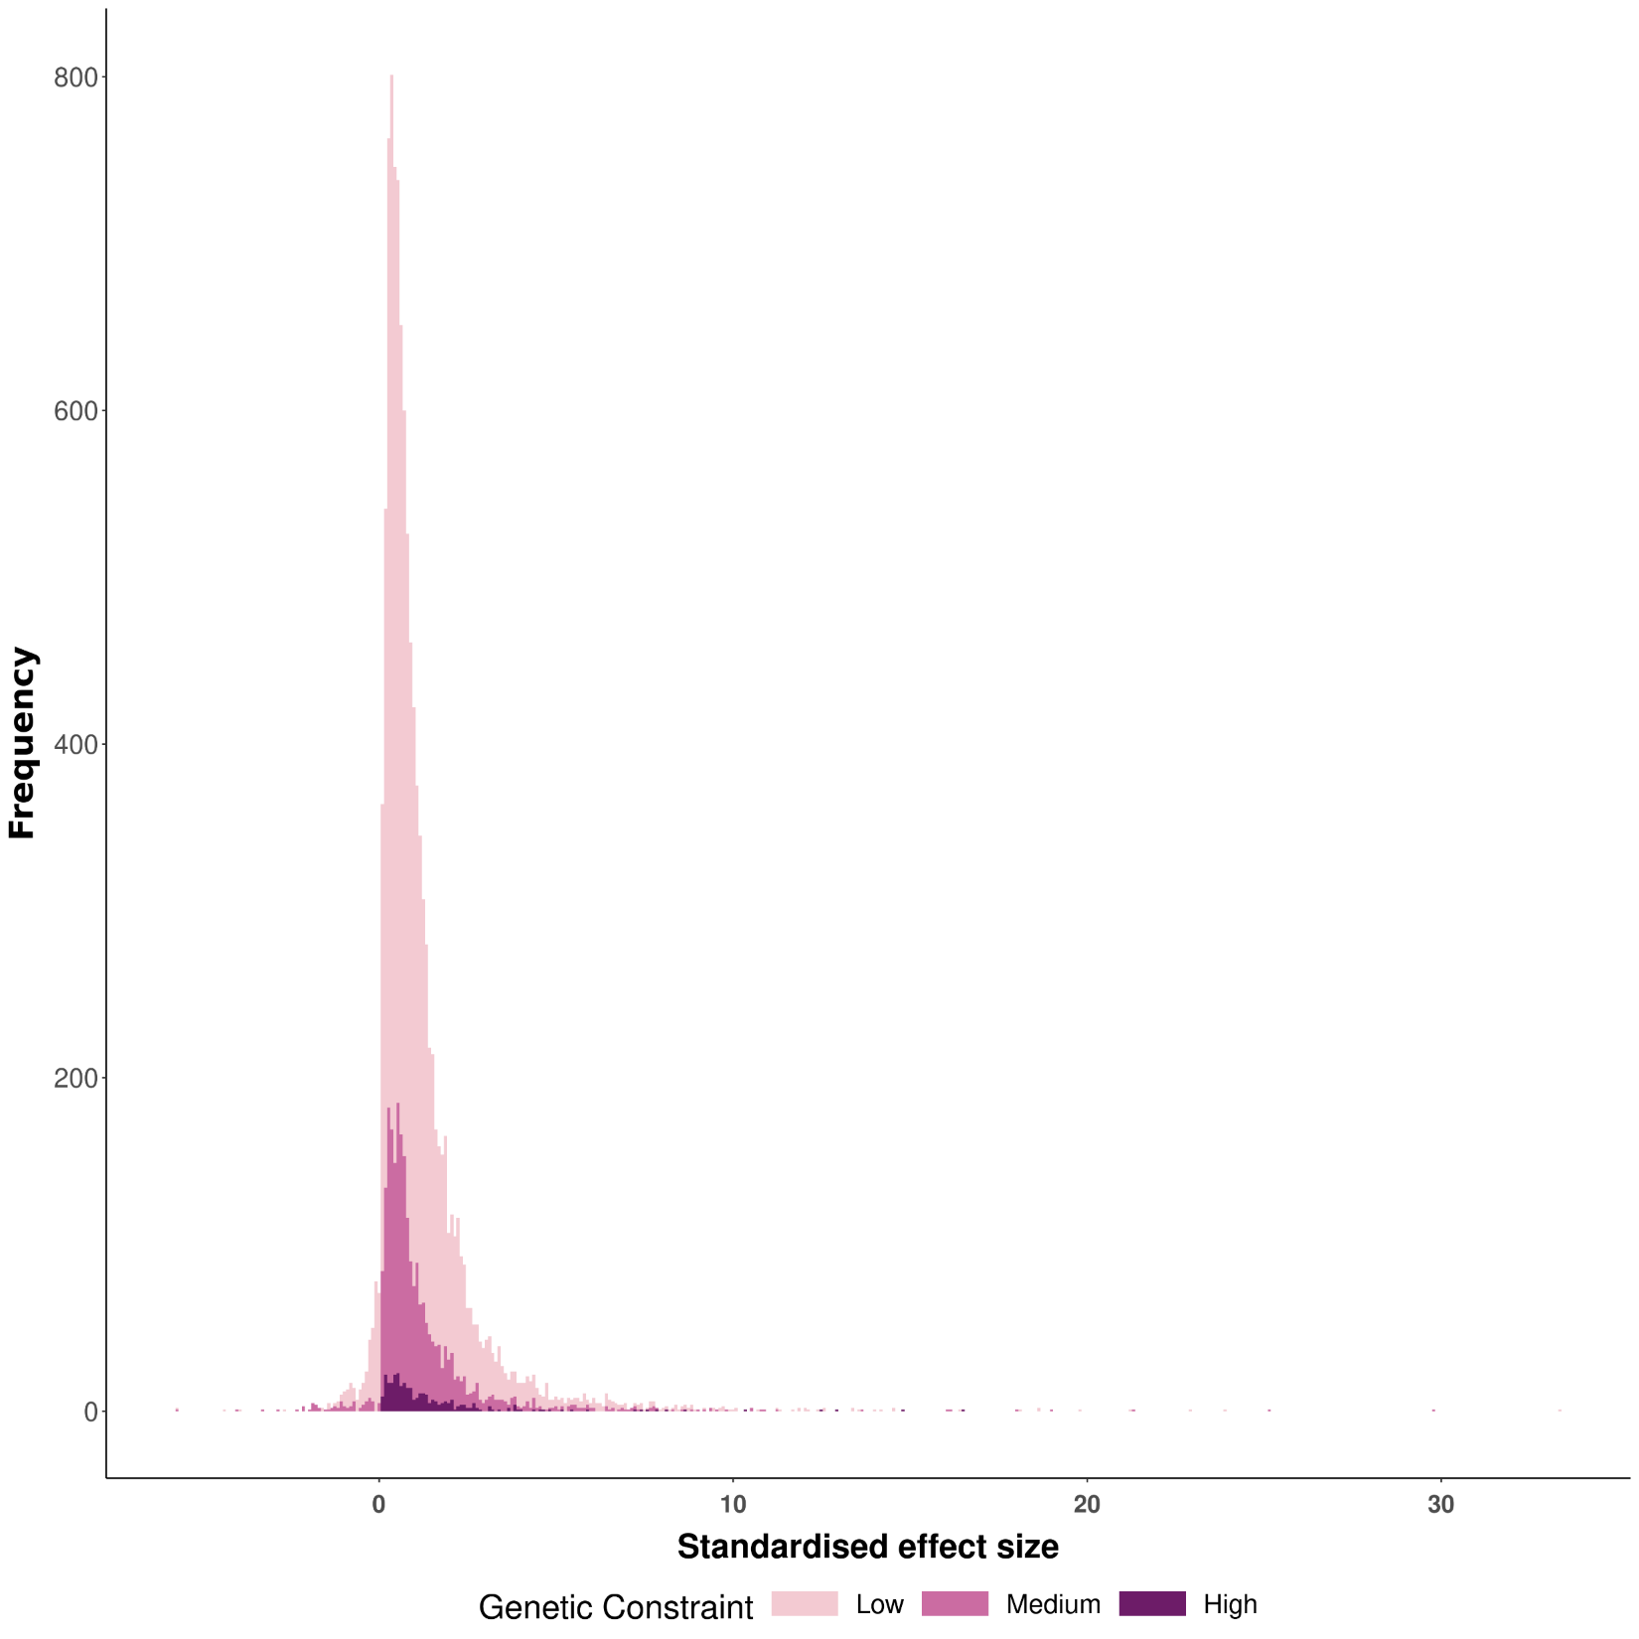
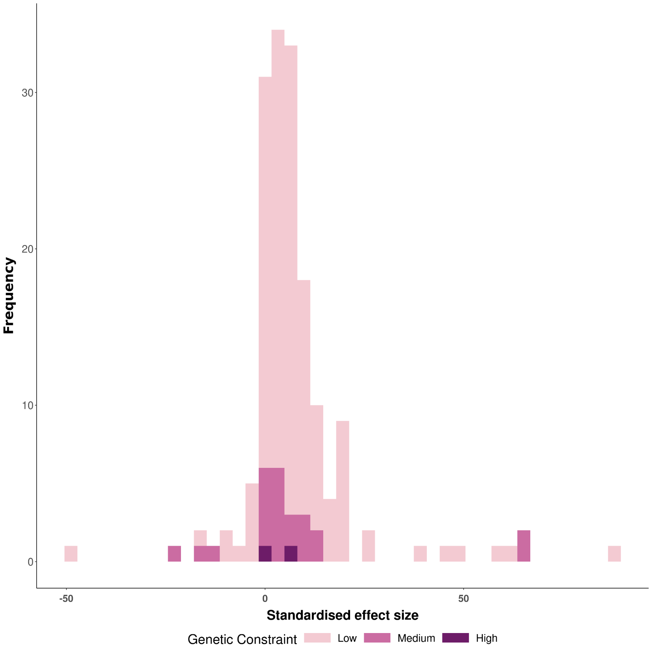


$$σ=1$$
$$σ=10$$
Notes:
As you can see, we have a pretty nice exponential distribution of effect sizes when mutational variability is low, however when high, there aren’t many fixations at all during adaptation. Part of this is likely due to adaptation not taking nearly as long, but also look at the x axis scale: on average, fixations are of larger fitness effect with variability is high, than when it is low – this explains why they reach the optimum so quickly, but then also, almost all mutations are strongly deleterious past that point because the large effects drag populations away from the phenotypic optimum.
Genetic constraint also seems to be working interestingly – high constraint means fewer QTL mutations, and it seems rather proportional. With sigma = 10, there’s too few fixations to really say much, but the same pattern appears to be occurring, although I wouldn’t expect it to be a statistically significant match to an exponential curve.

Slide 14
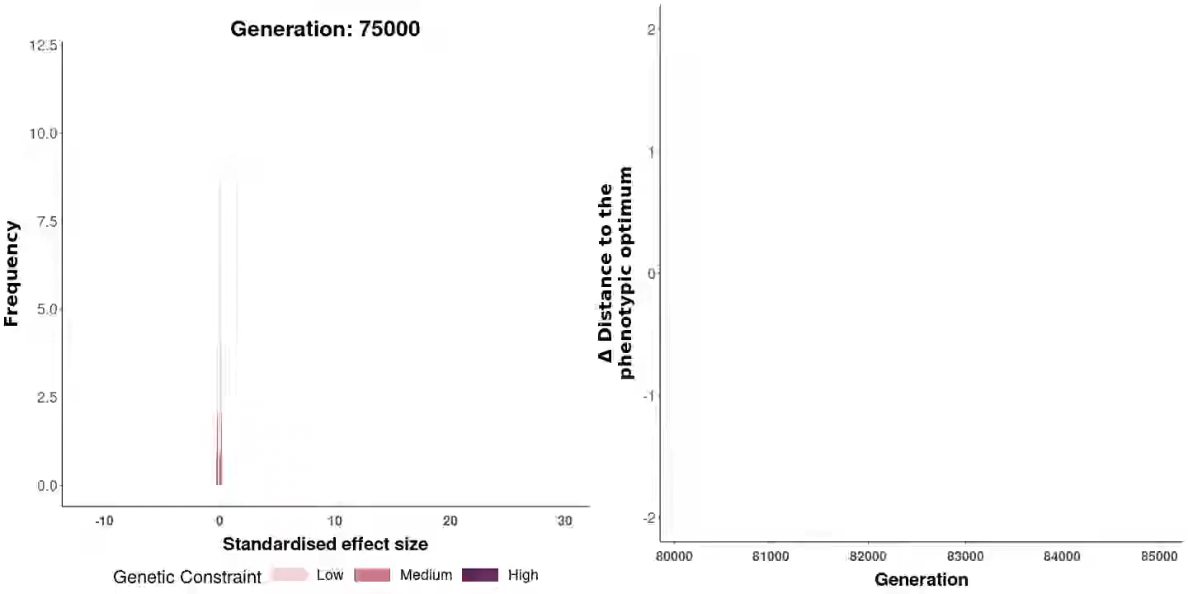
σ = 1
Notes:
But I hear you shout “But evolution happens through time Nick! This is after evolution has happened! What happens during evolution?”
It’s ok, I hear your prayers, and I deliver with an animation of the distribution of fixations changing over time. On the left we have the distribution of fixations according to their effect size, and on the left, the change in distance to the optimum over time. This is all for sigma = 1, so a relatively narrow curve of allelic effects.
Adaptation happens in the first thousand or so generations, then maintenance of variation, where there is an ebb and flow of various mutations to hover around the optimum.

Slide 15
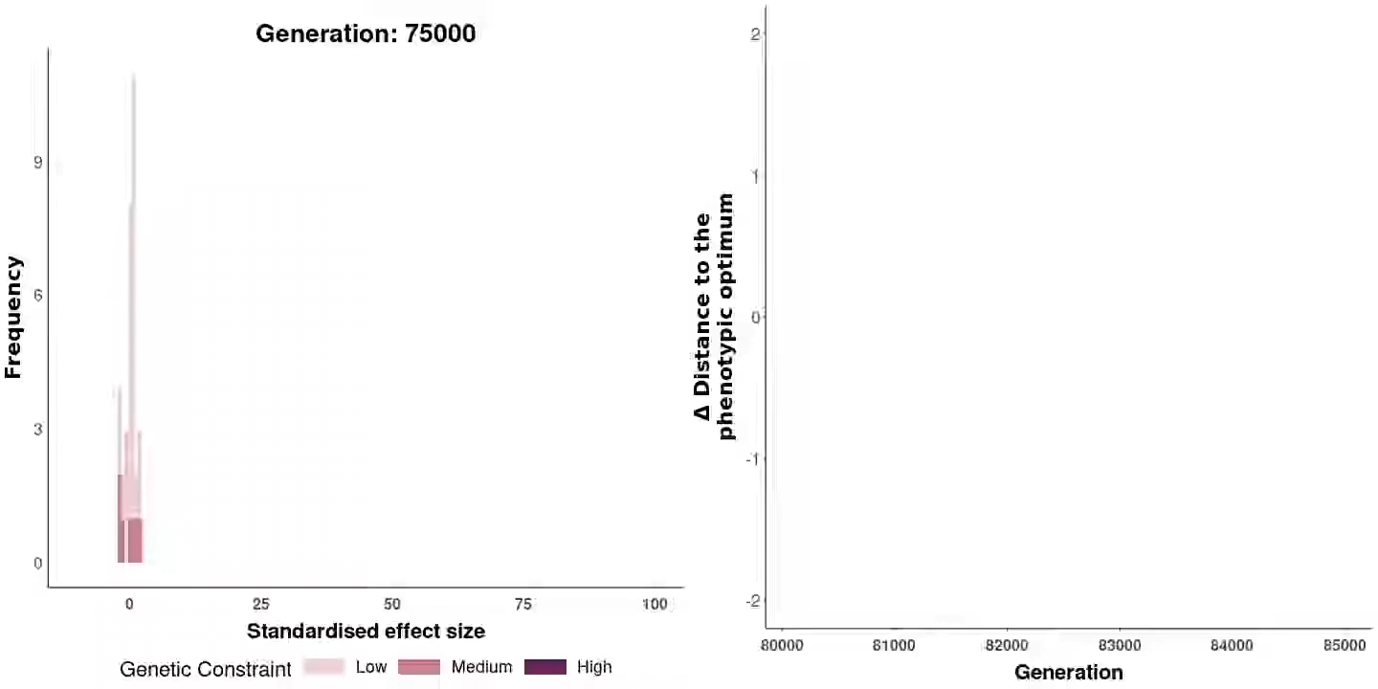
σ = 10
Notes:
Here, we have the more varied distribution of effects, sigma = 10
Adaptation is much faster, but populations are more volatile over time and don’t match the optimum as well. Note that there are considerably fewer fixations in general and they are of larger effect on fitness and phenotype. The ebb and flow behavior is still there.

Slide 16
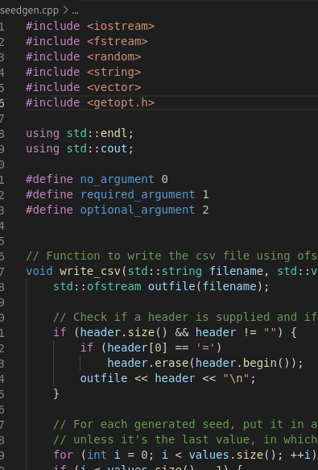
What’s next
Population genetics statistics
Tajima’s D
F_{st}
Watterson’s ϴ
Site Frequency Spectra
Large mutation > intermediate > small
Latin Hypercube Parameterisation
Make constraint continuous
More intuitive ways to visualize this data
Notes:
I’d like to add some more proven population genetics statistics to my model to infer what’s going on a bit more quantifiably
Tajima’s D, Fst, Watterson’s ϴ
In addition, I’ll likely explore site frequency spectra, and how each frequency range changes over time: there’s an expectation that large mutations should occur first during adaptation, then the fixations become progressively smaller and smaller in effect size
I’ll also likely add more levels of genetic constraint, and a figure out a way to treat it as a continuous scale so I can vary it as a Latin Hypercube parameter
Tracking mean trait movement over time, while also following allele frequencies simultaneously would be really cool

